Slide 1


Predict Rent Bike With Model Ordinary Least Square (OLS)
Statistic Business - Sekolah Data Pacmann
pacmann.io
© 2023 – Pacmann AI

Slide 2
Outline
Introduction
Datasets Description
Problem Statements and Goals
EDA (Exploratory data analysis)
Hipotesis test
Model OLS
Cross Validation
Conclution
Notes

Slide 3
Introduction
Notes:
Transisi antar outline

Slide 4
Introduction
In a bicycle rental company that wants to make predictions on its business, this company wants to know what affects the number of bicycle rentals. Some of the data that the company has is related to temperature, seasons, and holidays. Therefore, the company wants to know this with the statistical linear regression method, the results of which can later be used for business development needs.

Slide 5
Datasheets
Notes:
Transisi antar outline

Slide 6
Datasheets
Data Predictor:
Date : year-month-day Hour : hour of sell Temperature : Temperature in celcius Humidity : Humidity (%) Windspeed : Speed of wind (m/s) Visibility : Visibility(10m) Dew Point Temperature : Dew Point Temperature in celcius Solar Radiation : Solar Radiation of vehicle (MJ/m2) Rainfall : Rainfall (m) Snowfall : Snowfall (cm) Seasons : Seasons winter, summer, autnum, dan spring Holiday : Holiday / No Holiday Function day : Function day / No Function day
Outcome :
Rented_Bike_Count : Sum of rented bike

Slide 7
Problem Statements and Goals
Notes:
Transisi antar outline

Slide 8
Problem Statements
Problem Statement
Objective Question :
How about exploratory data analysis?
-) Which is including sum of rent the highest base on a few condition and proportion?
-) How is correlation between data?
2. How is hipotesis data test?
3. How is result model predictor with outcome, single predictor and multiple predictor?

Slide 9
Goals
Goals that will achive : 1. Know analysis causes much to say the least of rent_bike. 2. Prediction sum of rent_bike base on data. 3. Help company for increase business and right on target in add ren_bike in the future.

Slide 10
Eksplorasi Data Analysis
Notes:
Transisi antar outline

Slide 11
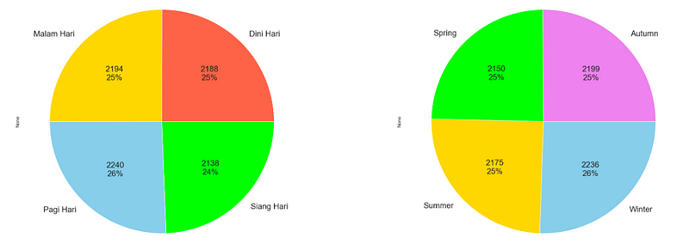
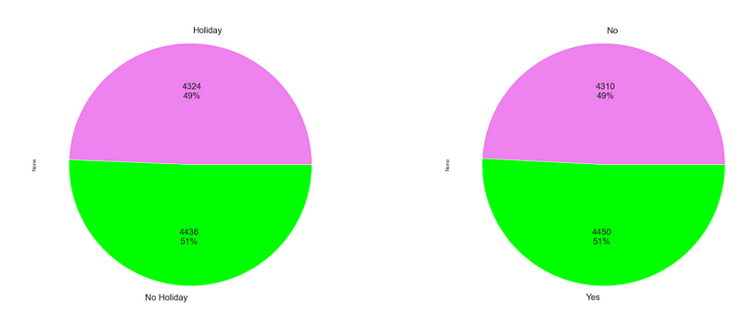
Eksplorasi Data Analysis
Proportion of column data

Slide 12
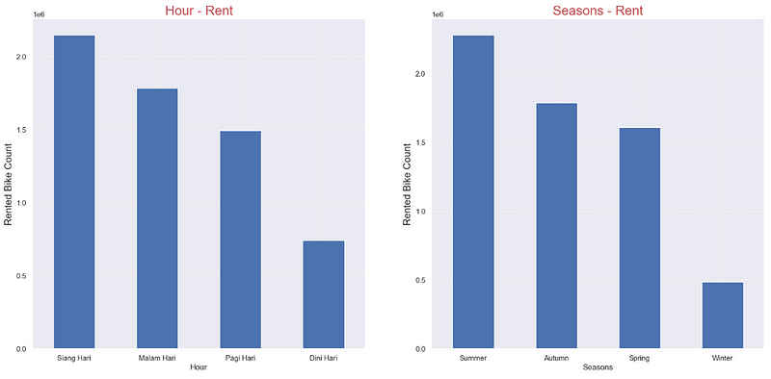
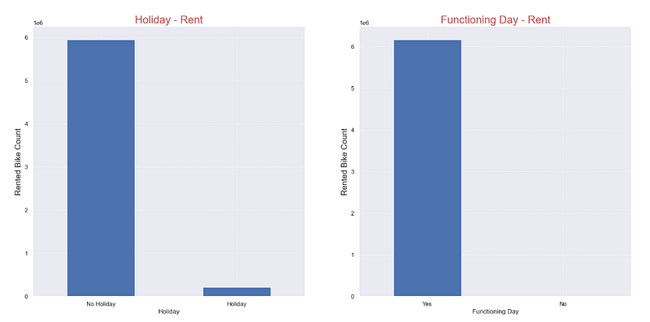
Eksplorasi Data Analysis
Proportion of column data
- Sum of rent_bike the highest on afternoon and season summer with sum is 2151060 and 2283234
- Holiday terbanyak ada di tidak holiday dan functional day sebesar 5956419 dan 6172314

Slide 13
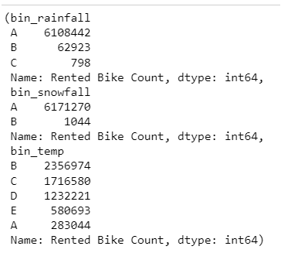
Eksplorasi Data Analysis
Check bin column rainfall, snowfall and temperature
Note :
A = No rain, B = Light rain, C = Moderate rain A = Light snow, B = Moderate snow A = Very cold, B = Cold, C = Normal, D = Hot, E = Very hot
Shows that rent_bike is highest when there is no rain and light snow during winter, and this makes sense because rent_bike is not effective in those conditions. Meanwhile, at most temperatures (Celsius) in cold conditions, this situation really makes sense where using a bicycle in cold conditions can heat up the body and is more effective and flexible in using it.

Slide 14
Eksplorasi Data Analysis (Correlation)
Notes:
Transisi antar outline

Slide 15
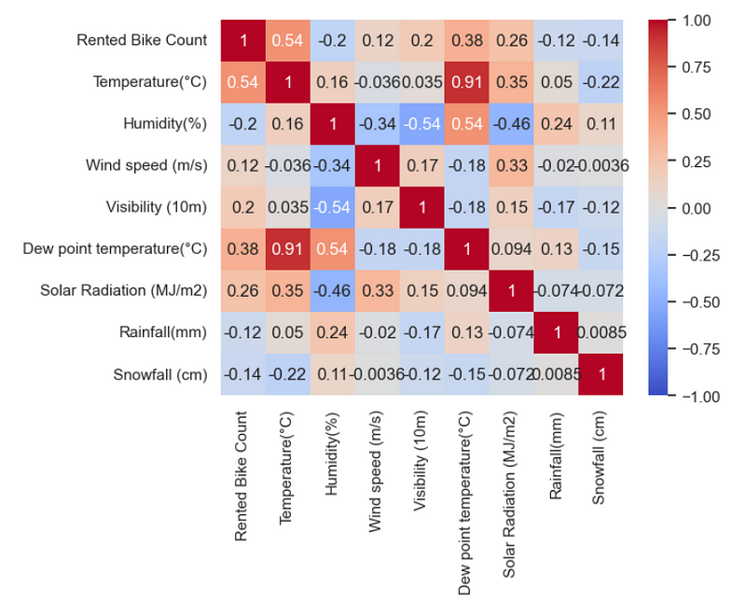
Eksplorasi Data Analysis (Correlation)
Category vs category (method chi-square) p-value < 0.05:
Columns is hour, seasons, holiday, dan Functioning Day:
Holiday vs Functioning Day, Holiday vs Seasons, dan Seasons vs Functioning Day.
Numeric vs Category (method spearman):
Column rent_bike_count vs seasons have correlation because p-value = -0.272.
Numeric vs numeric :
data outcome (rent_bike_count) have correlation the highest with column temperature C as big as 0.54, whereas column termpearture C have correlation the highest with dew point temperature.

Slide 16
Hipotesis Test
Notes:
Transisi antar outline

Slide 17
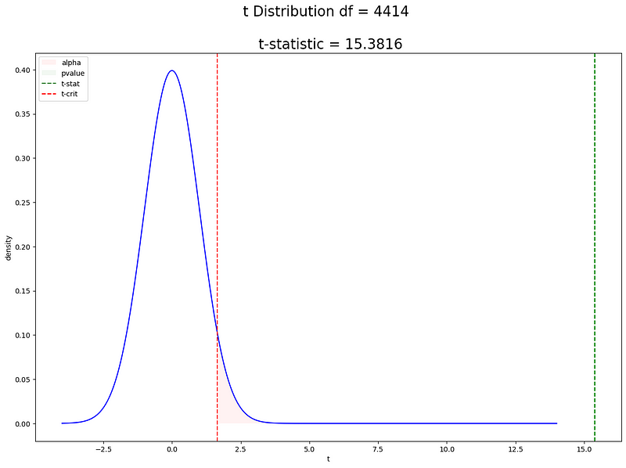
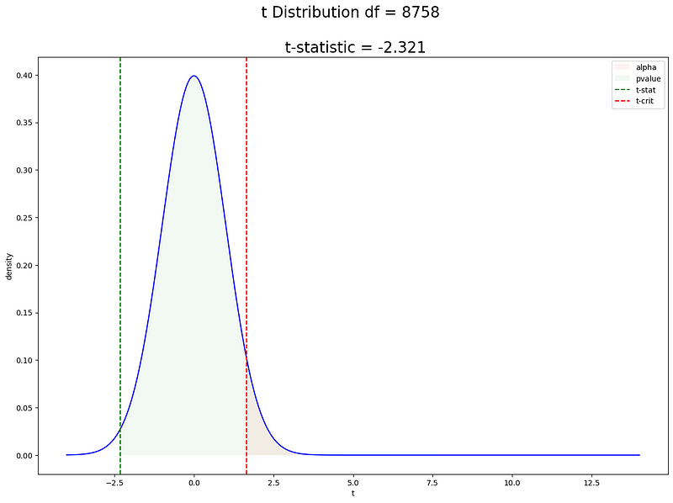
Hipotesis Test
Hipotesis predictor vs outcome H0 : outcome = predictor H1 : outcome (select equal)
1. Is H1 seasons (summer) ≥ seasons (spring) on rent_bike? The answer is hipotesis H0 rejected so perception H1 declared true. 2. Is H1 hour (Afternoon) ≥ hour (Morning) on rent_bike? The answer is hipotesis H0 rejected so perception H1 declared true. 3. Is H1 season (summer) ≥ hour (spring) on rainfall? The answer is hipotesis H0 rejected so perception H1 declared true.
Distribution If H0 Rejected
Distribution If H0 Recived

Slide 18
Hipotesis Test
Convidence Interval
We are trust that 95% range sum of rent_bike when seasons (summer) ≥ seasons (spring) as big as 342.79 – 265.28, hour (afternoon) ≥ hour (morning) as big as 336.72 – 262.44, and we are trust sum of rainfall when season (summer) ≥ hour (spring) as big as 0.15 – 0.012.

Slide 19
Modeling OLS
Notes:
Transisi antar outline

Slide 20
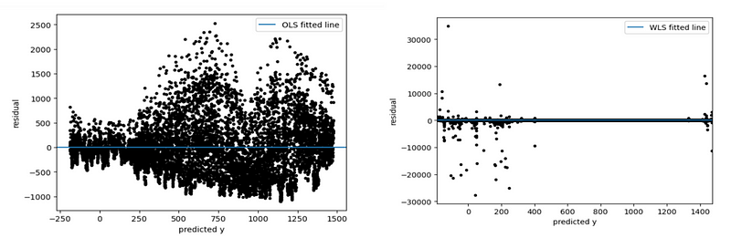
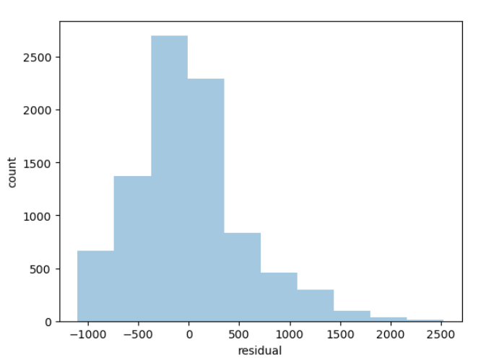
Modeling OLS
Single predictor vs single outcome (Temperatur vs rent_bike):
Residual without weight:
Residual with add weight
Normal error weight
R-square as big as 0.2900448841778287 and RSME as big as 543.4363268944784 and if we use multiple column predictor (seasons and temperatur vs rent_bike r-square and RSME is not far different.

Slide 21
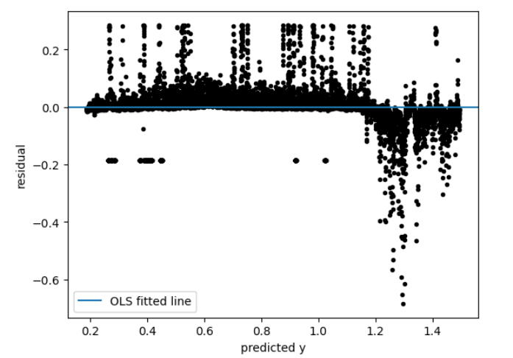
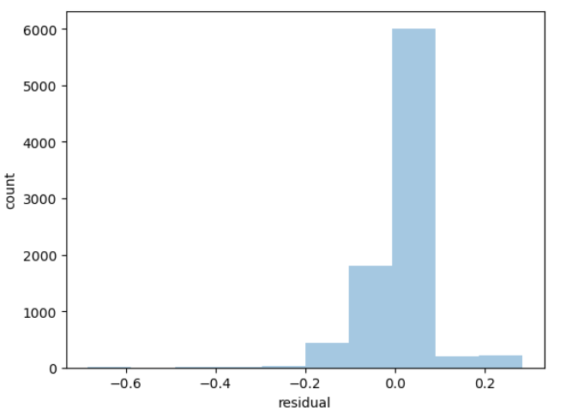
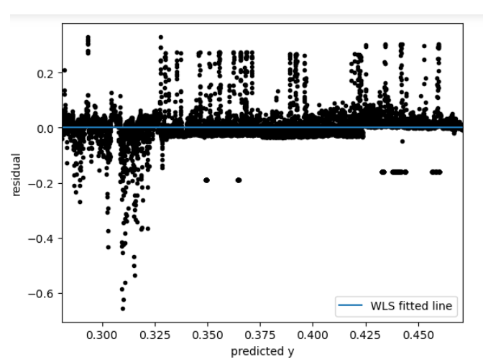
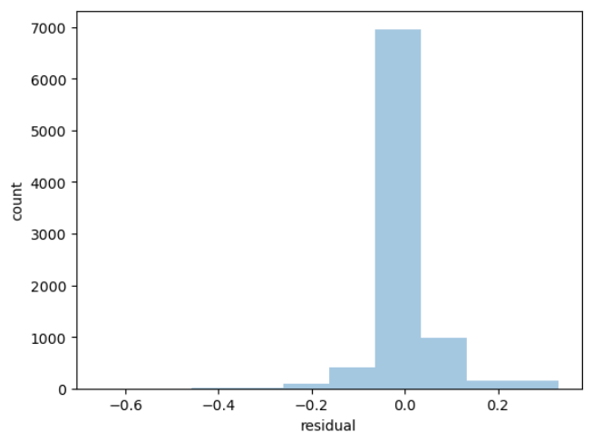
Modeling OLS
Transformation with normalizer columns:
Single column predictor :
R-square as big as 0.8493138352332285 and RMSE as big as 0.07159913422628561 very different with before.
Then interpretastion on model single predictor is : rent=1.011656+−0.825444(Temperature) where if temperatur value zero then sum of rent_bike increase as big as 1.011 but if temperatur have values input then values input will times with 0.824.
Multiple columns predictor:
R-square as big as 0.8705420413343773 and RMSE s big as 0.06636444372991242 very different with before.

Slide 22
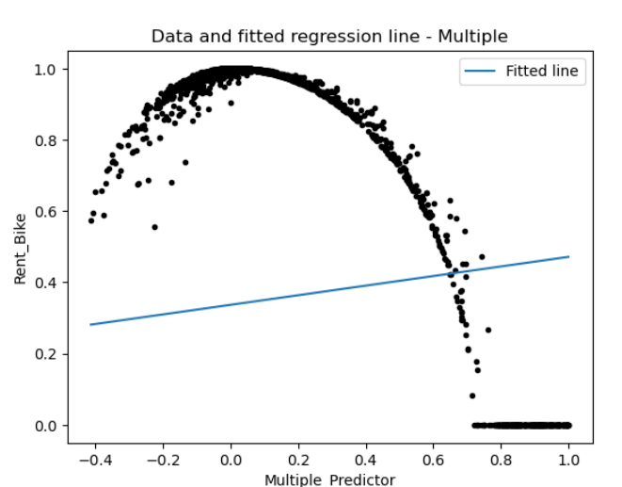
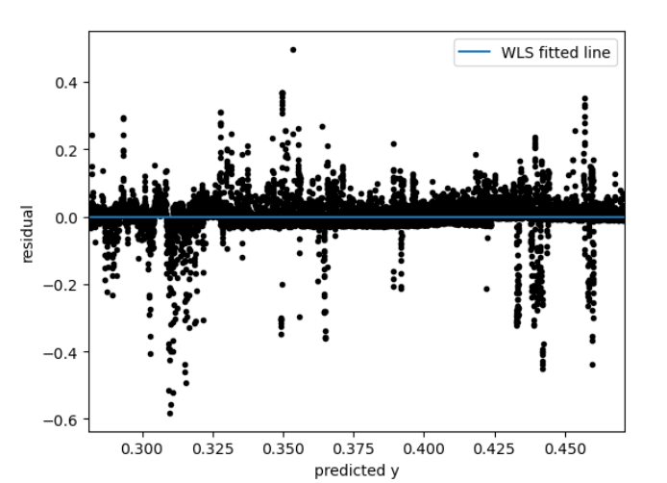
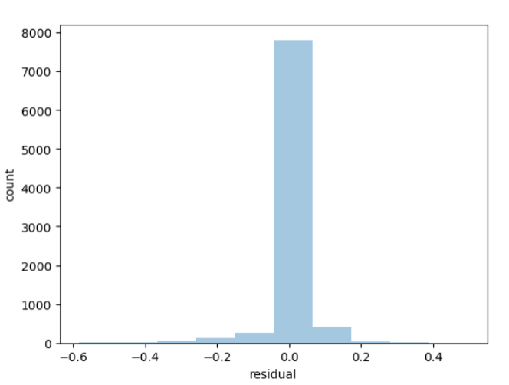
Modeling OLS
Transformation with normalizer columns:
Predictor : Seasons, Temperatur, and Daw_point_temp
Outcome : Rent_bike
Fit model
Residual
Distribution normal error
R-square as big as 0.9027724598842554 and RMSE as big as 0.05854512036425197 this Model is the best compared to other model before.

Slide 23
Cross Validation
Notes:
Transisi antar outline

Slide 24
Cross Validation
Cross Validation :
results for a single predictor of 0.846427169375399, multiple predictors of 0.8679665949287122 and multiple predictor_2 of 0.9009805543154353. It can be seen that none of these three transformation models are overfitting, so the model we choose as a prediction is multiple predictor_2 with the predictor column : seasons, temperature, and daw_temp. The result is:
rent = 0.816741−1.296807(𝑇𝑒𝑚𝑝𝑒𝑟𝑎𝑡𝑢𝑟𝑒) + 0.193949(𝑆𝑒𝑎𝑠𝑜𝑛𝑠𝐴𝑢𝑡𝑢𝑚𝑛) + 0.218329(𝑆𝑒𝑎𝑠𝑜𝑛𝑠𝑆𝑝𝑟𝑖𝑛𝑔)+ 0.218664(𝑆𝑒𝑎𝑠𝑜𝑛𝑠𝑆𝑢𝑚𝑚𝑒𝑟) + 0.183441(𝑆𝑒𝑎𝑠𝑜𝑛𝑠𝑊𝑖𝑛𝑡𝑒𝑟) + 0.539591(Dew_point_temp)
Mean is :
rent_bike 0.816741 if all variable 0
If Seasons_Spring = 1 then rent bike added 0.196308
If Seasons_Winter = 1 then rent bike added 0.218329
If Seasons_Autumn = 1 then rent bike added 0.218664
If Seasons_Summer = 1 then rent bike added 0.183441
If temperature and Dew_point_temp contain values, then times values with -1.296807 / 0.539591 and add with value intercept rent_bike.

Slide 25
Conclution
Notes:
Transisi antar outline

Slide 26
Conclution
-) Correlation predictor with outcome very influence model liner regression, whereas correlation outcome with predictor the highest then predictor
have correlation predictor column the highest too will influence increase model prediction
-) Added weight or not, the result from model have r-square low as big as 0.29 and RMSE high as big as 500
-) With transform data with normalizer method, single columns achive r-square 0.84 and RMSE 0.071, whereas multiple columns predictor Seasons, temperature, and daw_point_term achive r-square 0.90 and RMSE 0.05.

Slide 27
Notes
For do add rent_bike that big done when seasons spring and summer because addition the biggest compared to seasons others. Season that recommended need consider too about temperature because when input temperature high then sum of rent_bike will decrease and that we know user certain consider if temperature very hot. Besides that daw_point temp have high probability if the company utilise this metric because rising daw_point_temp then rent_bike rising too. So the company will obtain high probability when seasons spring and summer, temperature tend normal and cold in accordance with analysis EDA before and high daw_point_temp.

Slide 28
Thank You ^_^
Notes:
Transisi antar outline

